Slide 1
Exit Orientation

Slide 2
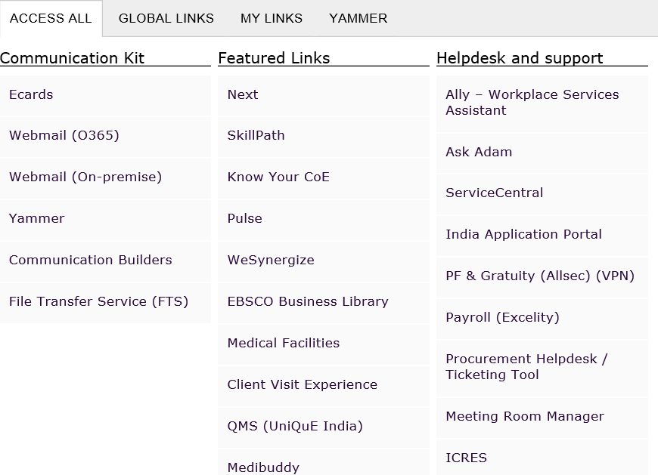
Login Procedure
Step 1: Go to Capgemini talent page link: https://talent.capgemini.com/in
Step 2: Please click on India Application Portal https://indiaapps.in.capgemini.com/Aspxpages/Applications.aspx
this can be seen in the below image:
Click

Slide 3
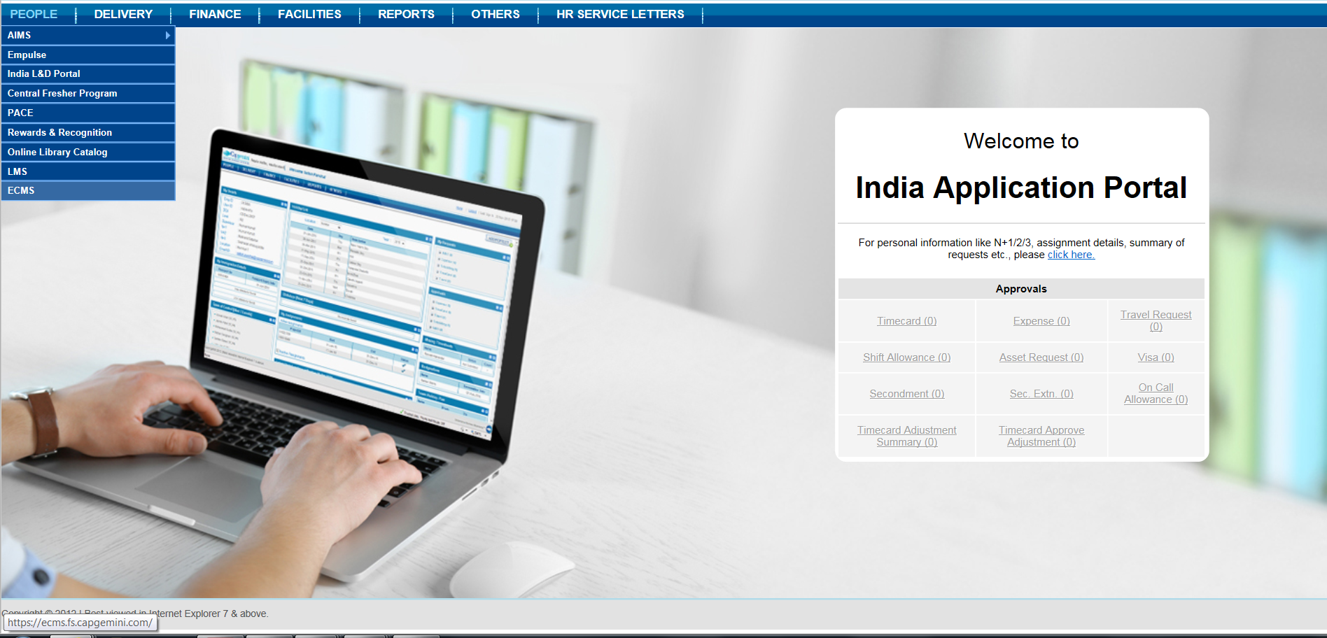
Once you login to India Application portal, you will be able to view the page as shown below
Exit Clearance Management System can also be accessed through: https://ecms.fs.capgemini.com/
ECMS

Slide 4
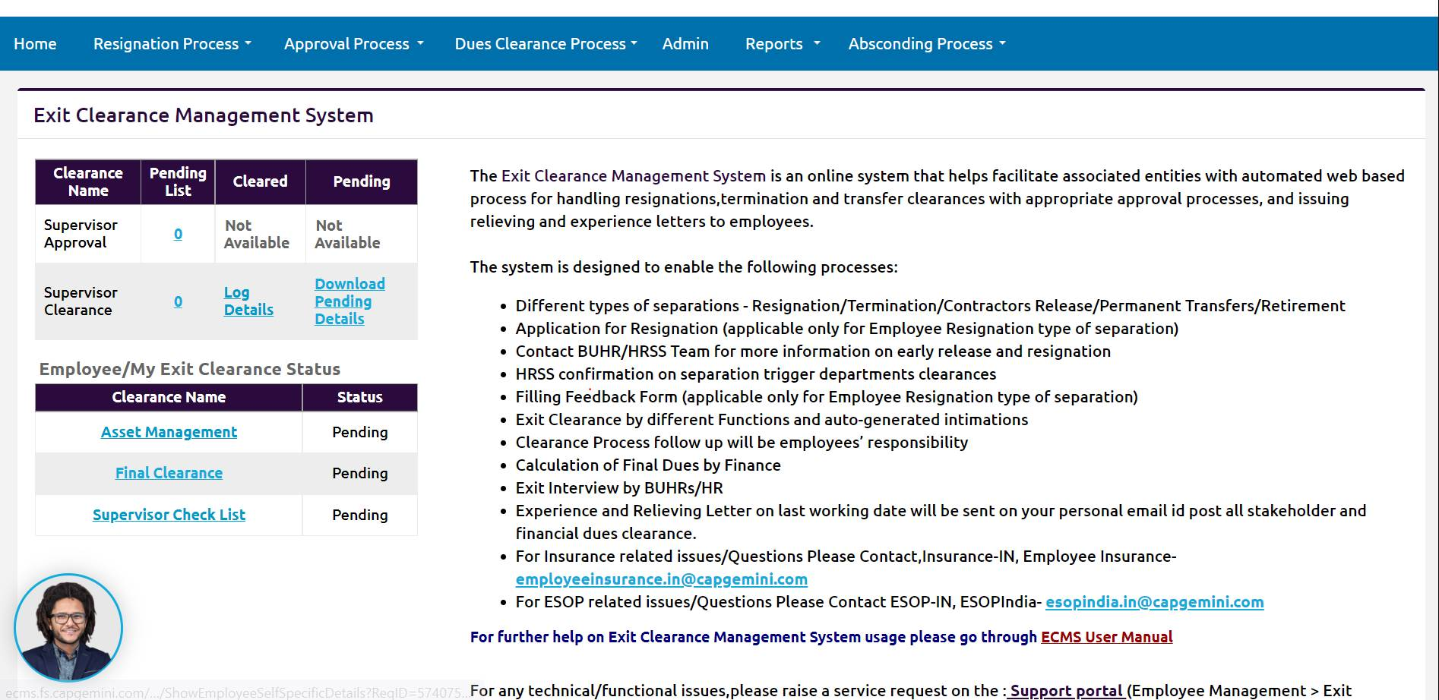

Slide 5
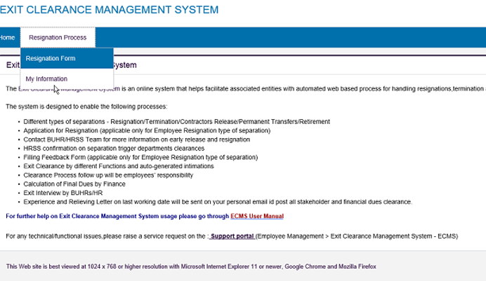
ECMS – My Information
This option appears in the “Resignation Process” dropdown and is viewable by all employees.
Below image illustrates the My Information tab:

Slide 6
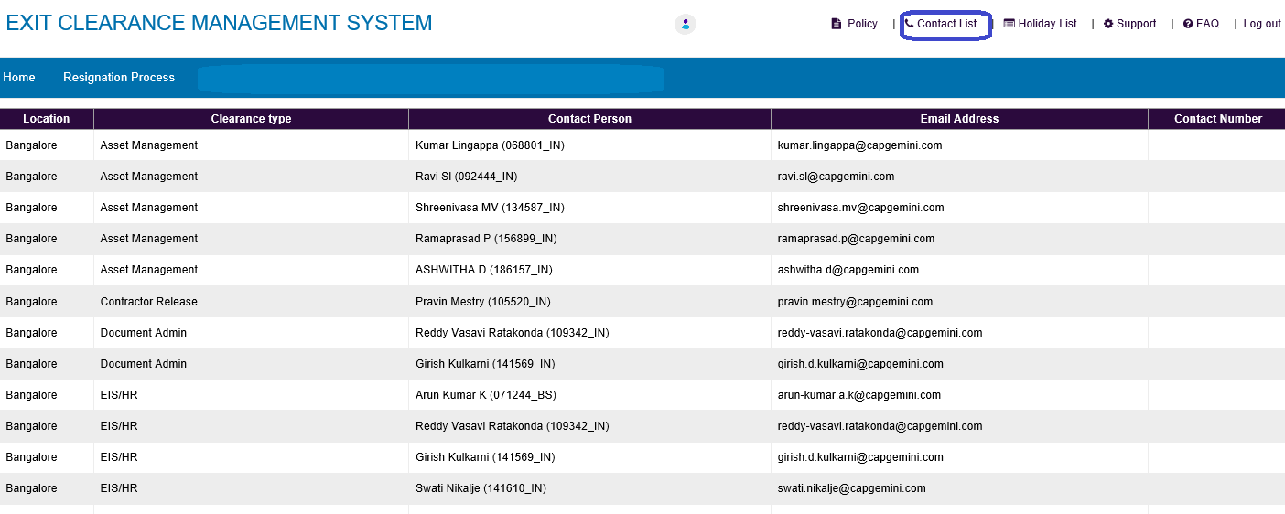
Key Notes - Exit Clearances
Validate / Update your Personal email Id & Contact details, as the same is used in future
ECMS Home Page – Resignation Tab – My Information
SPOC list details : ECMS Home Page – Top right – Contact List
Notes:
Fixar a posicao do titulo – sempre do lado esquerdo.
Sempre que tiver muito texto o coluna deve sempre ser “ narrowed” , se nao fica dificil de ler. Colocar paragrafos no texto.
Linha vertical deve ser mais fina e as pontas NUNCA devem ser arredondadas.

Slide 7
Continuation….
Exit clearances are part of exit formalities
Exit clearances completion is primary responsibility of an employee
Some of your clearances can to be completed before Last Working Day & clearance status can be checked in ECMS tool
Relieving and Experience documents will only be released on completion of all the clearances without dues
All the exit clearances can be completed online & for any due to be cleared please get in touch with exit team SPOC
Employees has to mandatorily follow exit clearances guidelines available in ECMS and ensure to follow up with all the department SPOC to complete the clearance on or before last working day
All the department clearances are mandatory
Contact : centralexit.in@capgemini.com

Slide 8
Shift/On-call Allowance:
Please ensure that you raise your Shift and On-call allowance before your Last Working day
Any shift or on-call not claimed via the tool will not be processed
Please note that your attendance and roster are updated on the tool
Once the details are updated you can raise a shift/on-call claim on the tool
In case of queries, please reach out to:
For technical queries please raise a ticket on http://help.capgemini.com -> Finance Application ->Shift Allowance.
For payment related queries please raise a ticket on http://help.capgemini.com -> Finance Applications ->PICS (Finance).
For change in approver definitions http://help.capgemini.com -> Finance Support ->Project Player Definition ->New PM Matrix definition
For policy or process understanding related query please reach out to your BUHR

Slide 9
List of Exit Clearances & Scope
Sequence | Clearance Name | No. of Sub Clearances | Clearance Completion Scope | Clearances
1 | Time Help Desk Dues Clearance | 1 | Before LWD | Time Helpdesk
2 | Supervisor Clearance | 6 | Before LWD | Supervisor
3 | EIS Due Clearances | 6 | Before LWD | HRSS-Exit Team
4 | BU HR Clearance | 1 | Before LWD | BU HR
5 | Finance Due Clearance | 19 | Before LWD | Forex/Payroll
6 | Learning & Development Clearance | 4 | Before LWD | HR-L&D
7 | Performance Management Clearance | 2 | Before LWD | HR-PMD
8 | Mobility Clearances | 2 | Before LWD | HR-Mobility
9 | People Process Clearances | 2 | Before LWD | HRSS-LMS
10 | ICRES Due Clearances | 4 | On LWD | ICRES/AMEX
11 | Asset Management Clearance | 4 | On LWD | ITICS
12 | Final Clearances | 1 | On LWD | HRSS-Exit Team
Notes:
Fixar a posicao do titulo – sempre do lado esquerdo.
Sempre que tiver muito texto o coluna deve sempre ser “ narrowed” , se nao fica dificil de ler. Colocar paragrafos no texto.
Linha vertical deve ser mais fina e as pontas NUNCA devem ser arredondadas.

Slide 10
1.0 Time Help Desk Clearance
Time helpdesk clearances can be completed before Last Working Day
Please ensure all the pending Time Sheets are filled and approved by your supervisor until your last working day
Employees needs to ensure that in India Timecard Application Portal, last 6 months (until LWD) timecard status should be in “Approved” status, post which supervisor can provide time clearance in ECMS portal
Time helpdesk clearances will be approved once the supervisor has approved the timesheet
Timesheet approval is important for clearance of People process
Please raise a ticket on service central for any queries
Notes:
Fixar a posicao do titulo – sempre do lado esquerdo.
Sempre que tiver muito texto o coluna deve sempre ser “ narrowed” , se nao fica dificil de ler. Colocar paragrafos no texto.
Linha vertical deve ser mais fina e as pontas NUNCA devem ser arredondadas.

Slide 11


2.0 Supervisor Clearance
Supervisor has to approve timesheet for the last 6 months before last working day
Please complete the assignment review at least a week prior to your last working day for yourself and your reportees (if any) in MyPath
This will help the People Processes/HR team to document timely performance feedback which will be used during the annual performance evaluation
If you are tagged as N+1, please reach out to RMG Team and get all the Ns de-tagged on or before your LWD
In case of any concerns, please write to tmsupport.global@capgemini.com
Timesheet & Expense clearance has to be approved by the supervisor before last working day
Notes:
Fixar a posicao do titulo – sempre do lado esquerdo.
Sempre que tiver muito texto o coluna deve sempre ser “ narrowed” , se nao fica dificil de ler. Colocar paragrafos no texto.
Linha vertical deve ser mais fina e as pontas NUNCA devem ser arredondadas.

Slide 12
3.0 People Process Clearance
Please ensure to update all the availed leaves in LMS and Clarity / Time card (time sheets) with appropriate leave code & approved by your supervisor at least three days prior to the last working day
Once time sheet & supervisor clearance is completed people process clearance can be provided
Please update the eligible shift allowances and get it approved from your supervisor and project owner at least three working days prior to the last working day
This clearance will only be given after 24 hours of your time clearance
For further clarification, write to people process Team hrssams.ig@capgemini.com
Notes:
Fixar a posicao do titulo – sempre do lado esquerdo.
Sempre que tiver muito texto o coluna deve sempre ser “ narrowed” , se nao fica dificil de ler. Colocar paragrafos no texto.
Linha vertical deve ser mais fina e as pontas NUNCA devem ser arredondadas.

Slide 13
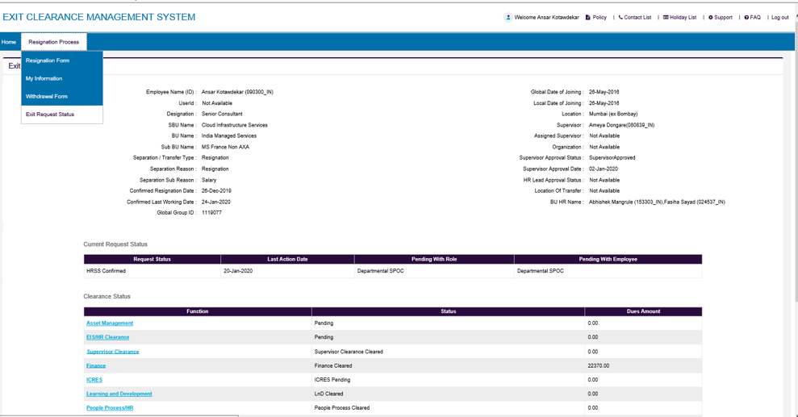
4.0 EIS Due Clearance
EIS clearance will be completed 2 days prior to the last working day
Notice Period shortfall days will be updated in ECMS one day prior to the last working day
Kindly have a check on exit request status every often, as the status of clearances will be updated and accordingly you can follow-up.
Notes:
Fixar a posicao do titulo – sempre do lado esquerdo.
Sempre que tiver muito texto o coluna deve sempre ser “ narrowed” , se nao fica dificil de ler. Colocar paragrafos no texto.
Linha vertical deve ser mais fina e as pontas NUNCA devem ser arredondadas.

Slide 14
5.0 BU HR Clearance
Business HR can provide clearance before last working day
People Partner clearance is given by respective BU HR.
Note : People Partner/ BU HR clearance is not given by Exit Team SPOC
BU HR details can be viewed in ECMS
Exit Orientation | January 2020
© 2020 Capgemini. All rights reserved.
Notes:
Fixar a posicao do titulo – sempre do lado esquerdo.
Sempre que tiver muito texto o coluna deve sempre ser “ narrowed” , se nao fica dificil de ler. Colocar paragrafos no texto.
Linha vertical deve ser mais fina e as pontas NUNCA devem ser arredondadas.

Slide 15
6.0 ICRES Dues Clearance
ID card needs to be submitted by all employees on or before your LWD.
If the ID/access card does not reach the office on or before your LWD there would be a charge of
Rs. 500/- each
ID/access card should be submitted to the ID card cell either self drop or personal courier to their respective
base locations
Avoid handing over the ID/access card to the vendor on account of the delay
Drawer Keys (If any):
Please handover your drawer keys (if applicable) to the ICRES team on or before LWD
AMEX Card:
Clearance will be given 10 days before LWD for employees who are not holding Corporate AMEX Card
Employees holding Corporate AMEX Card and having any dues are requested to get in touch with the team 15 days before their LWD and settle it directly with AMEX vendor
Clearances will be given only if the account shows “0” balance
Note :To speed up the clearance process, kindly share the screen shot of payment details with Amex help desk team.
Notes:
Fixar a posicao do titulo – sempre do lado esquerdo.
Sempre que tiver muito texto o coluna deve sempre ser “ narrowed” , se nao fica dificil de ler. Colocar paragrafos no texto.
Linha vertical deve ser mais fina e as pontas NUNCA devem ser arredondadas.

Slide 16
7.0 Asset Management Clearance
IT Asset Clearance will be provided only post submission of assets are surrendered
Transfer of asset (desktop/laptop) is not allowed.
Recovery will be applied if the asset is in damaged condition
Early submission of asset needs supervisors email approval
For desktop submission which is not in use and in office, please raise a request well in advance so that clearance is provided on time.
To raise PC /laptop Surrender request:
Please Login below portal.
https://servicecentral.capgemini.com/sc -> Order or Request -> PC Surrender
*Office Drop : you have to raise PC Surrender request 5- 7 days prior to your LWD, and this will be applicable to Associates who are available within city limits and Employee should come and submit asset in person.
“Please visit Capgemini office between 09:00 to 17:00 from Monday – Friday (Working days)
*Remote Pickup: you have to raise PC Surrender request 15 days prior to your LWD It will be applicable to Associates who are Outside City and no near Capgemini Office available, Request should submit with valid details so vendor will co-ordinate & schedule the asset pickup accordingly.
Helpdesk contact number:
Email: ithelp.global@capgemini.com
Phone (internal): 484357; Phone (external):+91 226 755 7744
Web: https://servicecentral.capgemini.com/sc
Pickup Vendor (FLYTTA Helpdesk details):
Flytta helpdesk number on +91 8069206800 / 9866496464/ or you may send email: on cg.wpe@goflytta.com with PC Surrender request number
To know tagged Asset & Asset Allocated location details:
Please login into below URL, please surrender accordingly:
https://servicecentral.capgemini.com/myassets_home.do?sysparm_view=MyCompanyAssets
Notes:
Fixar a posicao do titulo – sempre do lado esquerdo.
Sempre que tiver muito texto o coluna deve sempre ser “ narrowed” , se nao fica dificil de ler. Colocar paragrafos no texto.
Linha vertical deve ser mais fina e as pontas NUNCA devem ser arredondadas.

Slide 17
7.1 Asset Management Clearance…contd.
For any asset related queries, send email to us Along with Asset clearance SPOCs add
hamassetrecovery.in@capgemini.com
Office drop - Asset clearance will be provided within 48hrs post submission, excluding weekends
Vendor pick – Delay by minimum 15-20days post submission of asset and once it reaches the office location.

Slide 18
8.0 Finance Due Clearance
Please connect with Finance SPOC 7 days prior to your last working day
Forex:
If you have any Onsite travel you need to get in touch with forex team to verify your record by providing them your relevant documents like
LOA
Per Diem Annexure Form
Passport Immigration along with stamps having your travel period mentioned in it or else Project Manager’s e-mail approval
Please get your record verified with forex team in case you have claimed Travel Kit Allowance or Relocation Cost.
The same is not applicable for employees on Transfer.
Payroll:
It is mandatory to upload investment proofs in Payroll (HGS) 3 days before LWD, if applicable
Proof submitted on emails will not be “Accepted” for FnF settlement
Notes:
Fixar a posicao do titulo – sempre do lado esquerdo.
Sempre que tiver muito texto o coluna deve sempre ser “ narrowed” , se nao fica dificil de ler. Colocar paragrafos no texto.
Linha vertical deve ser mais fina e as pontas NUNCA devem ser arredondadas.

Slide 19
8.1 Finance: Payroll portal
Please Login HGS Portal. All Documents available on HGS portal for Active & Exit EMP.
https://ess.hgsbs.com/login?company=CG
Form 16
F&F statement
!. Global id:
2) Password - Refer your mail with the subject "WELCOME TO ESS" u will find default password & enter the password which will prompt to u to reset password use chrome or Edge
3) You do not remember password. Skip the 2nd option try 4th option
4) Go to the Forgot password option.
5) New page open fill your DOB & DOJ – New password generated your personal mail id in ECMS Records.
6) Again, go to link https://ess.hgsbs.com/login?company=CG
7) Global ID –
8) Password – (please fill you receive forgot password)
9) New page (Change password) open
10) Current password – is you receive (Forgot Password)
11) Create new password & confirm password
***Please note: Password to Open Form 16 for FY 21-22 is your PAN in capital
Make sure you update your personal mail id on ECMS application and My connect portal
Please note your final settlement statement Pay slip with IT computation sheet has been updated on the HGS Portal under Reports.
You can access the HGS portal using the below link: https://ess.hgsbs.com/login?company=CG
Login Id: Your Global ID
Password:
If you forget your password, please login with your Global Id mentioned in subject line and click on forget password

Slide 20
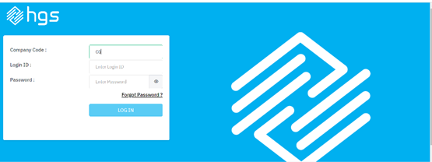
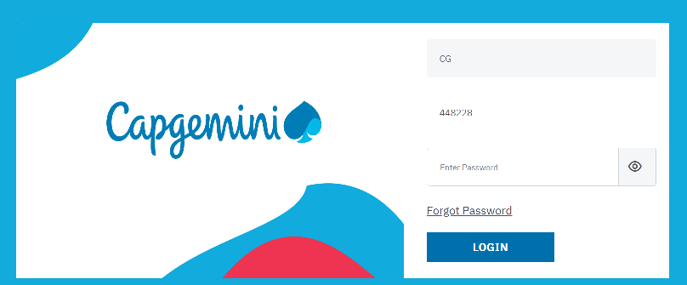
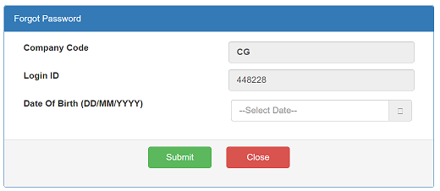
8.2 Finance: Payroll portal- Steps to login HGS Portal
https://ess.hgsbs.com/login?company=CG
Step 1: Employee code should be CG (capitals) Step 2: Enter CGGID and click on Forgot password
Step 3: Enter DOB and click on submit button, the new password email will go to Capgemini mail box.
Please note: Please complete the process before your LWD.

Slide 21
9.0 Learning & Development Clearance
L&D clearance can be completed 45 days before last working day
L&D – Library:
Auto clearance is provided in case you do not have any books
Books should be returned “at least 45 days” prior to the last working day
For any queries or concerns, please contact Library SPOC
L&D Certification:
Please get in touch with the L&D certification clearance role holder 7 days before LWD
L&D role holders names are available on ECMS - Contact list Note : Training cost recoverable is updated by the L&D team in amount section.
Notes:
Fixar a posicao do titulo – sempre do lado esquerdo.
Sempre que tiver muito texto o coluna deve sempre ser “ narrowed” , se nao fica dificil de ler. Colocar paragrafos no texto.
Linha vertical deve ser mais fina e as pontas NUNCA devem ser arredondadas.

Slide 22
10 Performance Management Clearance
Employees must complete their assignment review 7 days prior to their LWD
PMD clearance will be provided manually only for people managers (N+1). For below C1 grade it will be auto approved in the system
If you are tagged as N+1, please reach out to the RMG team and get all the Ns de-tagged before LWD
In case of any concerns please reach out to tmsupport.global@capgemini.com
Notes:
Fixar a posicao do titulo – sempre do lado esquerdo.
Sempre que tiver muito texto o coluna deve sempre ser “ narrowed” , se nao fica dificil de ler. Colocar paragrafos no texto.
Linha vertical deve ser mais fina e as pontas NUNCA devem ser arredondadas.

Slide 23
11 Mobility Clearance
Clearance can be completed 7 days before last working day if you do not hold any visa’s
Please get your record verified with IAS / Mobility team, in case you hold valid Work Permit / Visa / Residence Permit Card
For any queries or clarification, please contact IAS / Mobility admin as mentioned in contact list
For further queries connect to : _ias.in@capgemini.com
Notes:
Fixar a posicao do titulo – sempre do lado esquerdo.
Sempre que tiver muito texto o coluna deve sempre ser “ narrowed” , se nao fica dificil de ler. Colocar paragrafos no texto.
Linha vertical deve ser mais fina e as pontas NUNCA devem ser arredondadas.

Slide 24
12 Final Clearance
Final Clearance applicability:
It will be auto approved on the last working day post completion of all clearances subjected to no recovery
In case of recovery, employee has to settle the dues, post confirmation on the amount credited, Final clearance will be provided
Once final clearance is completed, relieving & experience letter would be auto generated & triggered to the employee, subjected to no dues towards any departmental clearance
Digital letters with digital signature will be released to employee’s personal mail id within 24 hrs from Final Clearance completion
In case of any departmental dues, if employee fails to pay within 3 working days post intimation, then final clearance will be closed & letters will be on hold until FnF completion
Once F&F is completed,
If the settlement amount is positive, then letters will be released
If the settlement amount stands negative, post payment from the employee and confirmation of credit, letters will be released.
The mode of payment would be online transfer(NEFT & RTGS only).
Bank details are available in the next slide.
Notes:
Fixar a posicao do titulo – sempre do lado esquerdo.
Sempre que tiver muito texto o coluna deve sempre ser “ narrowed” , se nao fica dificil de ler. Colocar paragrafos no texto.
Linha vertical deve ser mais fina e as pontas NUNCA devem ser arredondadas.

Slide 25
Bank Details
Fund Transfer type : NEFT only
Amount: Rs._______/-
Beneficiary Name: Capgemini Technology Services India Ltd.
Bank Name : BNP Paribas
IFSC : BNPA0009009
Bank Address : BNP Paribas House, 1 North Avenue, Maker Maxity, Bandra Kurla Complex, Bandra East, Mumbai 400 051
Bank Account Number : CAPGEMEXITEMPLOYEE ID NUMBER
Account Type : Current account
Note: Bank Account number is combination of “CAPGEMEXIT” fix words, without space, adding Employee Number.
Below are the scenarios -
If Natasha is having her Employee ID 001234 then account number is CAPGEMEXIT001234
If Natasha is having her Employee ID 012345 then account number is CAPGEMEXIT012345
If Natasha is having her Employee ID 123456 then account number is CAPGEMEXIT123456
If Natasha is having her Employee ID 12345678 then account number is CAPGEMEXIT12345678
Please note once you make payment before 6 PM of the day we shall be able to check and confirm the receipt of payment next day by EOD & if you make payment after 6 PM of the day then we shall be able to check and confirm the receipt of payment after 2 days.
If we do not receive any response or payment within 3 working days, we shall close your case for FFS which will take 30 days and letters will be released post that if amount will be
positive.
Notes:
Fixar a posicao do titulo – sempre do lado esquerdo.
Sempre que tiver muito texto o coluna deve sempre ser “ narrowed” , se nao fica dificil de ler. Colocar paragrafos no texto.
Linha vertical deve ser mais fina e as pontas NUNCA devem ser arredondadas.

Slide 26
Capgemini Account details :
Beneficiary Name: Capgemini Technology Services India Ltd.
Bank Name : BNP Paribas
IFSC : BNPA0009009
Bank Address : BNP Paribas House, 1 North Avenue, Maker Maxity, Bandra Kurla Complex, Bandra East, Mumbai 400 051
Bank Account Number : CAPGEMEXITEMPLOYEE ID NUMBER
Account Type : Current account
Bank Details
Altran Technologies India Pvt Ltd:
Aricent Technologies Holding LTD.
GLOBAL EDGE SOFTWARE LTD
Beneficiary Name | Altran Technologies India Pvt Ltd
Bank Name | BNP PARIBAS
Bank Address | EAST TOWERS (SOOD TOWERS), 1ST FLOOR, 25, BARAKHAMBA ROAD, NEW DELHI - 110001
Bank A/c No. | 0906510988200119
IFSC Code | BNPA0009065
Account type | Current Account
BENEFICIARY NAME | GLOBAL EDGE SOFTWARE LTD
BANK NAME | CITI BANK
BANK ADDRESS | MG ROAD, BANGALORE
BANK A/C NO. | 0522597031
IFSC CODE | CITI0000004
ACCOUNT TYPE | CURRENT ACCOUNT
Account Name | Aricent Technologies Holding LTD.
Bank Name | CITI BANK N.A.
Bank Account # | 2122006
IFSC/SWIFT Code | CITI0000002
Branch | New Delhi
Account Type | Current Account

Slide 27

We are pleased to announce the launch of first ever voice based HRSS - Smart Services Desk, the new age solution for our serving notice period employees.
Smart Services Desk is launched with the aim to make sure that all exiting employees have a hassle -free offboarding experience.
Objectives here is to facilitate voice - based support to all our current exiting employees as primary point of contact for any exit queries. Easing the communication for providing quicker resolutions.
Capgemini being a multi-cultural organization, we want to establish a trustworthy connection for the serving notice period employees.
The SSD service is available from Monday to Friday 9 am to 5:30 pm IST, the dial in number +91 80 66442727/+91 80 41834009
You may call them on the number displayed on the ECMS portal or above for any of your exit queries.

Slide 28
Important Points
Download payslips, IT Computation Doc from HR workways before last working day, follow the link:- https://ess.hgsbs.com/
Full & Final settlement will be completed within 30 days post your final clearance is completed & statement will be shared to your personal mail ID.
Form 16 is available post completion of financial year during the month of June/ July
For ESOP query, please write to esopindia.in@capgemini.com
For any support after exit do write to, offboardingservices.in@capgemini.com
For Ex-Employment Verification please inform your new employer to drop a mail to verification.in@capgemini.com
For Sodexo Card Queries – consumer@india.sodexo.com
For Shift Allowance Queries - shiftallowancequery.fssbu@capgemini.com
Notes:
Fixar a posicao do titulo – sempre do lado esquerdo.
Sempre que tiver muito texto o coluna deve sempre ser “ narrowed” , se nao fica dificil de ler. Colocar paragrafos no texto.
Linha vertical deve ser mais fina e as pontas NUNCA devem ser arredondadas.

Slide 29
Escalation Matrix -
Process Related Queries – exitorientation.in@capgemini.com
Level 1 – Janardhana Rao janardhana.rao@capgemini.com
Level 2 – Bunyan, Michael michael.bunyan@capgemini.com

Slide 30
Thank You...
Good luck and best wishes for your future endeavors

